Slide 1


DATABASE PROJECT PRESENTATION
PROJECT TITLE- EASY GO CAR RENTAL
PROJECT DONE BY – 1.TANMOY MAZUMDAR-4NI19IS104
2.SOURABH KUMAR -4NI19IS099
The National Institute of Engineering Department of Information and Engineering
MYSURU-570008 MYSURU-570008
2021-2022

Slide 2

WELCOME TO THE PRESENTATION OF EASYGO CAR RENTAL

Slide 3
INTRODUCTION
Nowadays, there is Online Car Rental which gives much benefit to user. A rental service is a service
which customers arrive to request the hire of a rental unit. It is more convenient than carrying the cost of
owning and maintain the unit. A car rental is a company that rent automobiles for short period of time for a
fee for few hours or a few days or a week.
It helps to book the cars or vehicles online rather than using the traditional manual system of vehicle reservation.
This eliminates the risk of erroneous booking and reduce overall lead time and ensures growth in customer satisfaction.
They can book any car according to their brands and price.
Our Project EasyGo Car rental System provides the users easy and convenient way to rent available
cars on the basis of brands and car types with privilege of selection of pickup and Drop Location and also
the date for the pickup and drop. And a auto generated bill is provided to the user on the basis of
the service they have chosen.

Slide 4
THIS PRESENTATION IS ALL ABOUT THE WORKING AND FLOW OF THE WEBSITE
TOOLS AND TECH STACK USED
• Operating System: Windows 10
• Database: MySQL database
• Front end: HTML/CSS/JavaScript
• Back end: PHP
•XAMPP Server

Slide 5
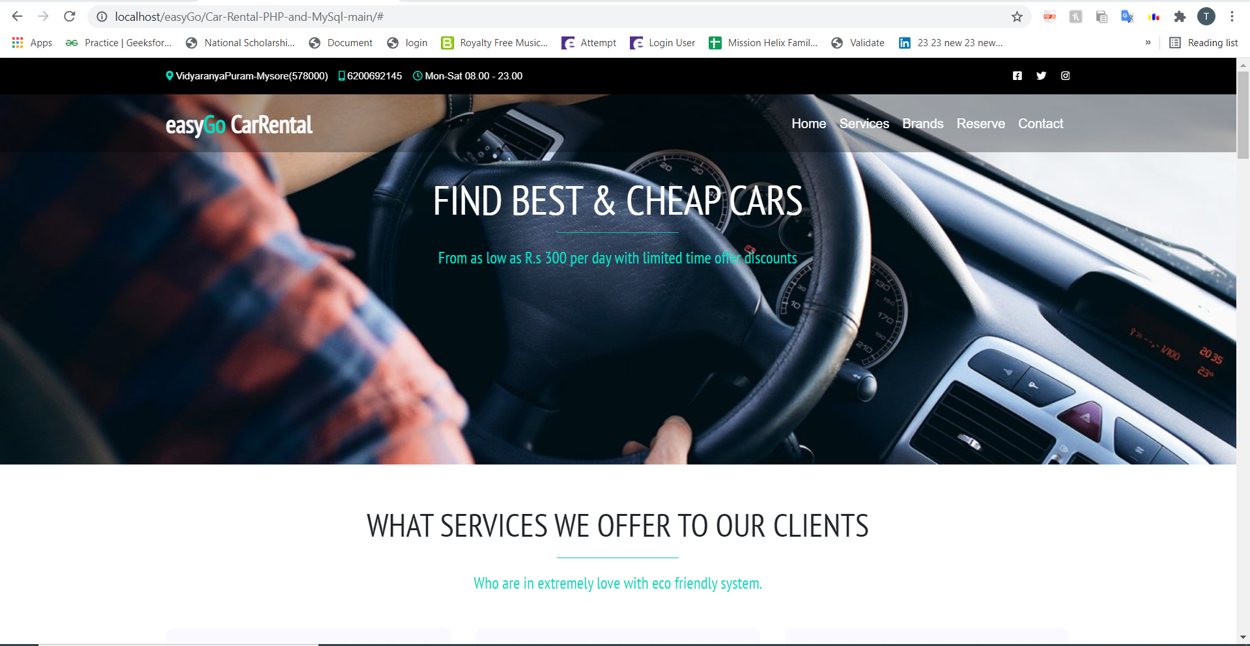
Frontend

Slide 6
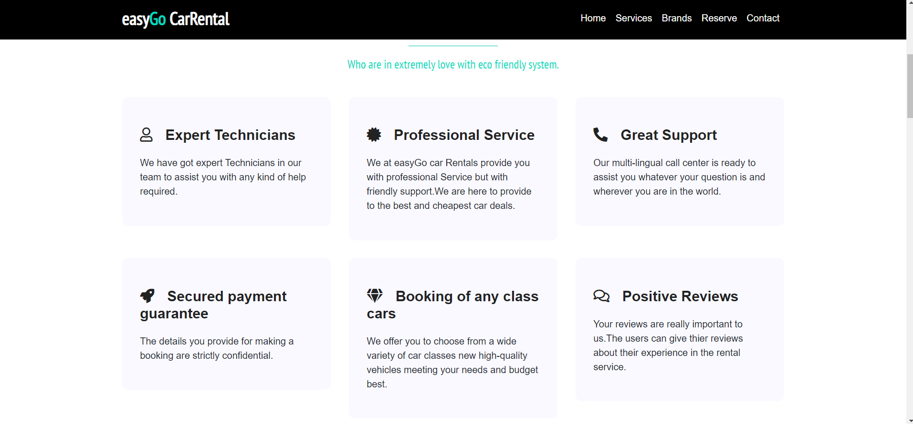
Description of the services provided by easyGo Car Rental

Slide 7
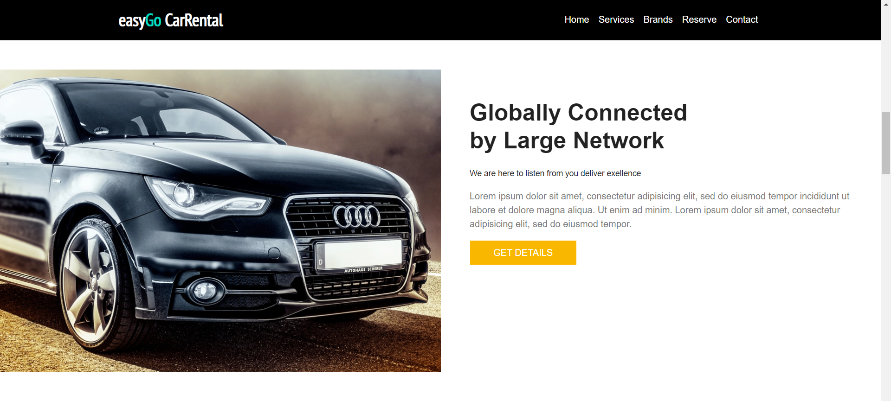
Globally Connected by Large Network

Slide 8
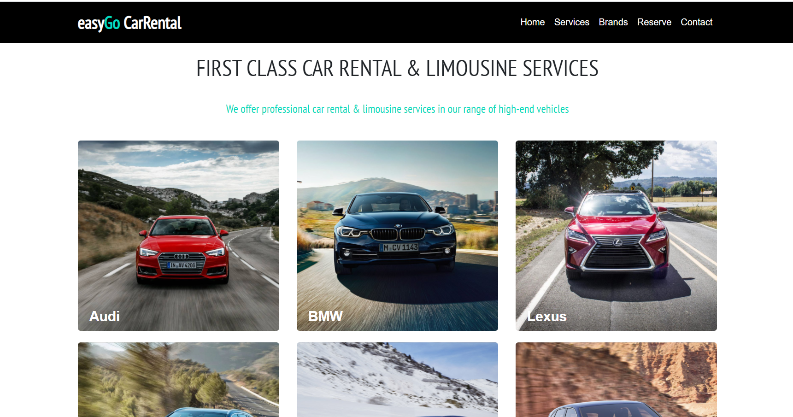
Car Brands Provided by easyGo Car rental

Slide 9
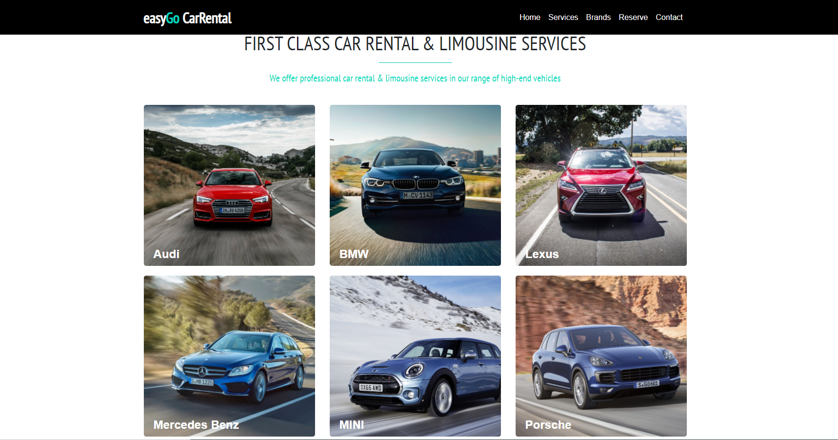

Slide 10
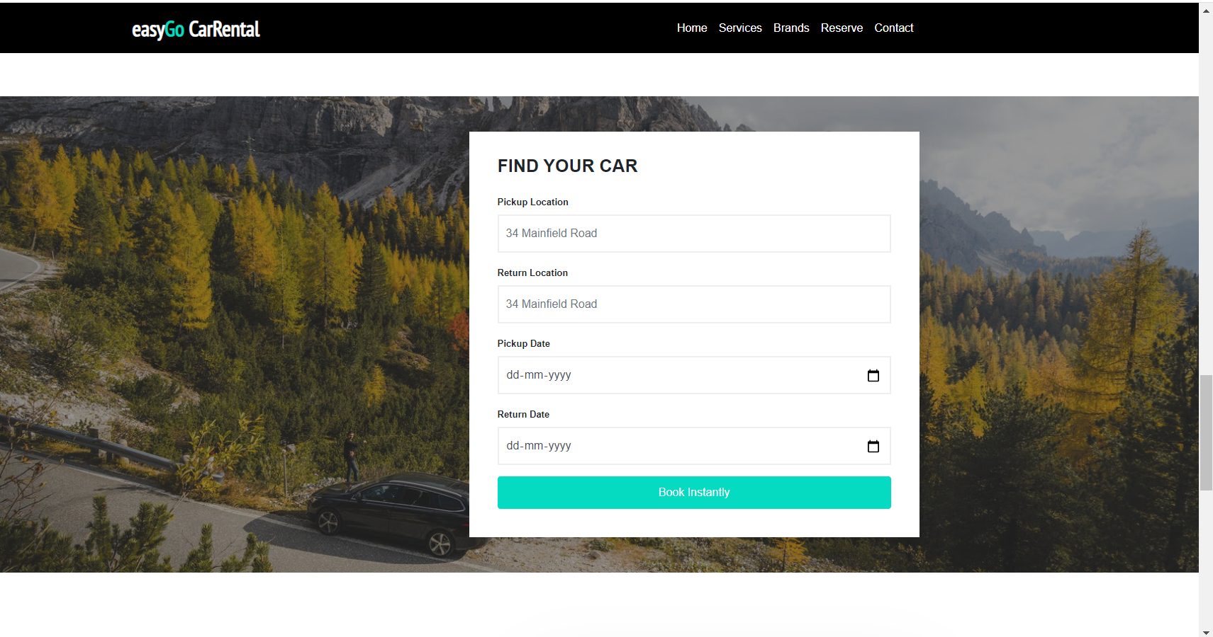
Reserve your car by pickup and drop location with pickup and return date

Slide 11
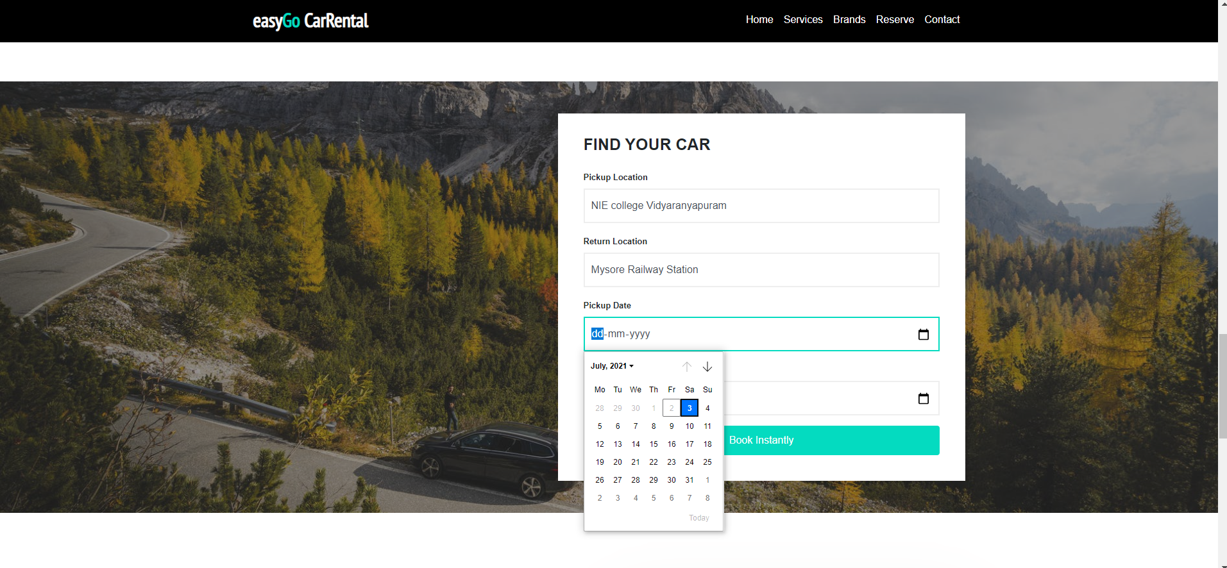

Slide 12
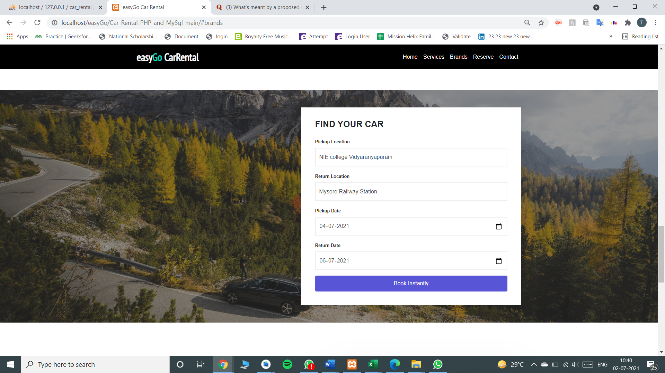

Slide 13
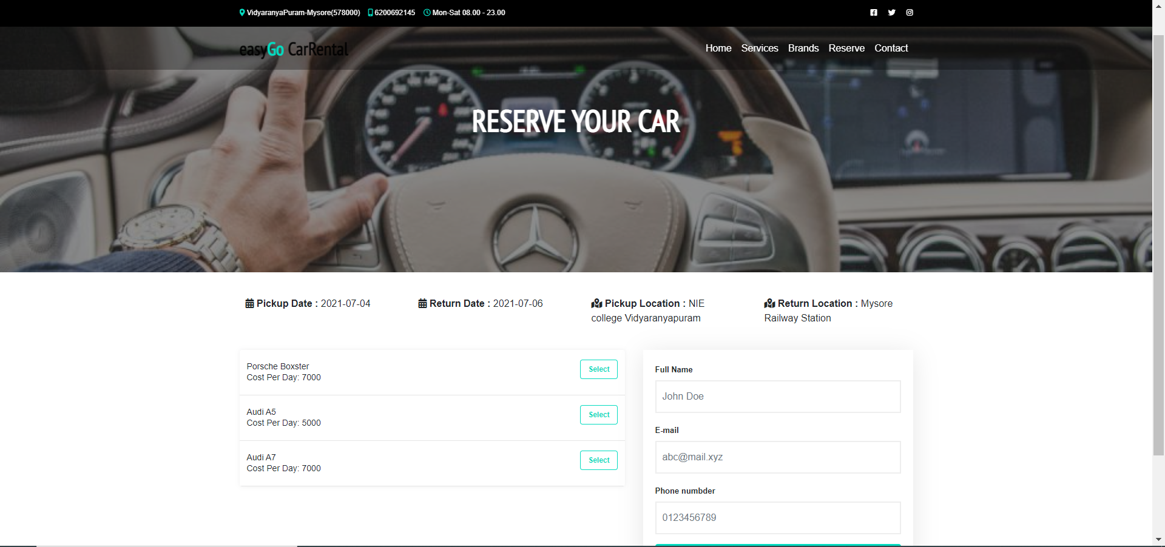
Select your specific car with the cost per day of each car Provided

Slide 14
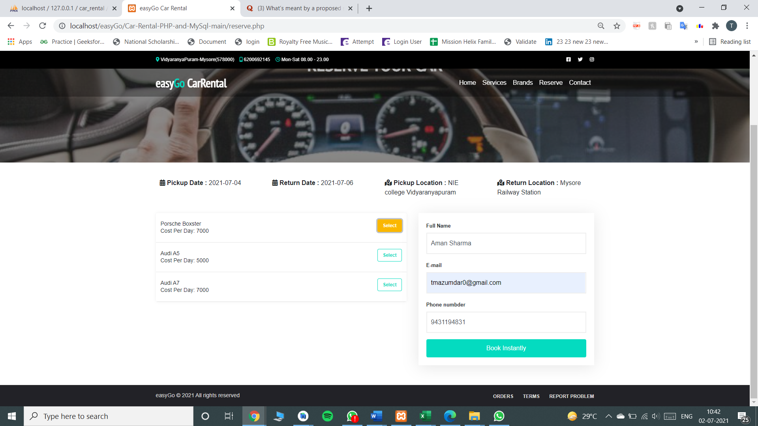
Insert your personal details for booking instantly

Slide 15
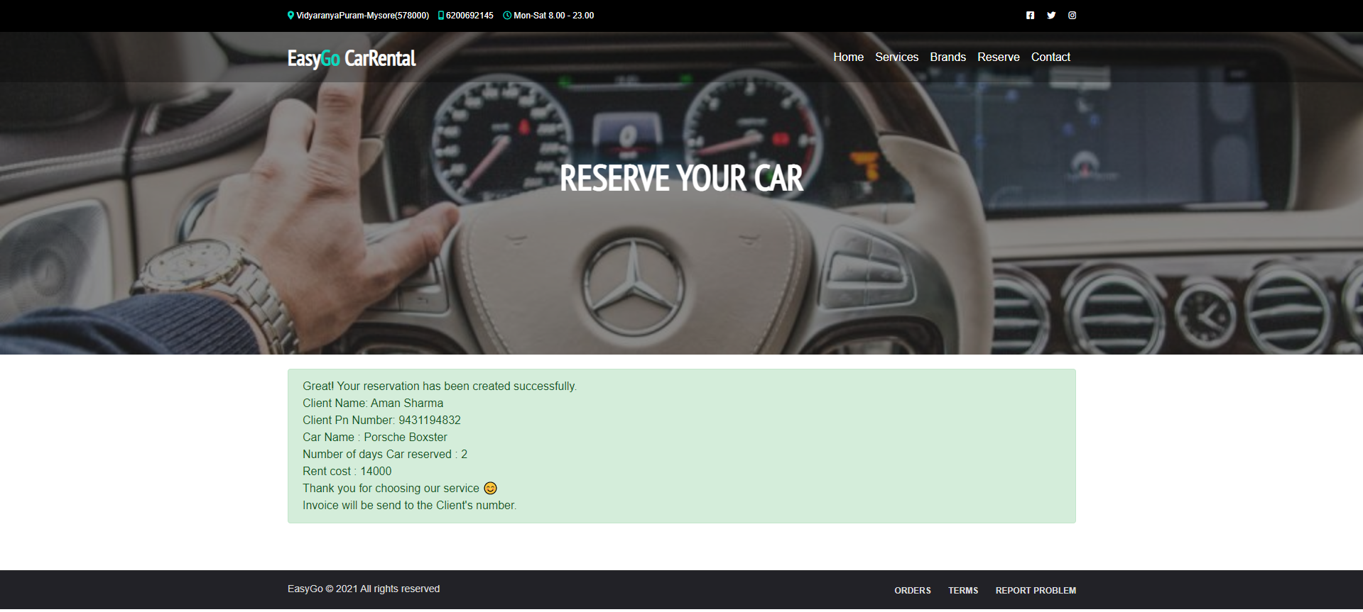
Confirmation page for your reservation with details of your reservation displayed

Slide 16
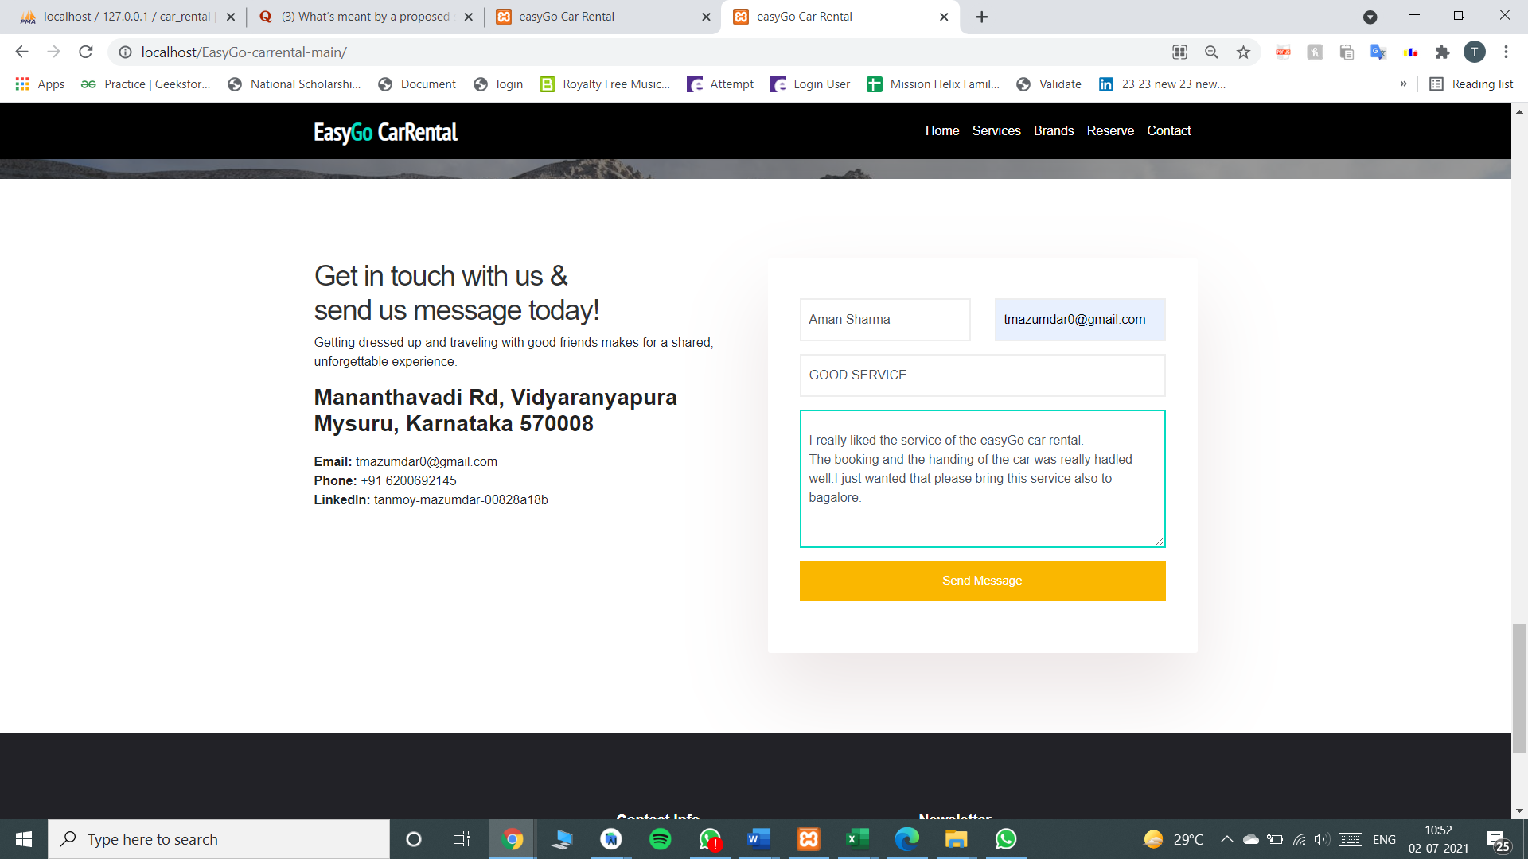
User can Get in Touch With us ,raise any issue or give feedback Directly for the service provided

Slide 17
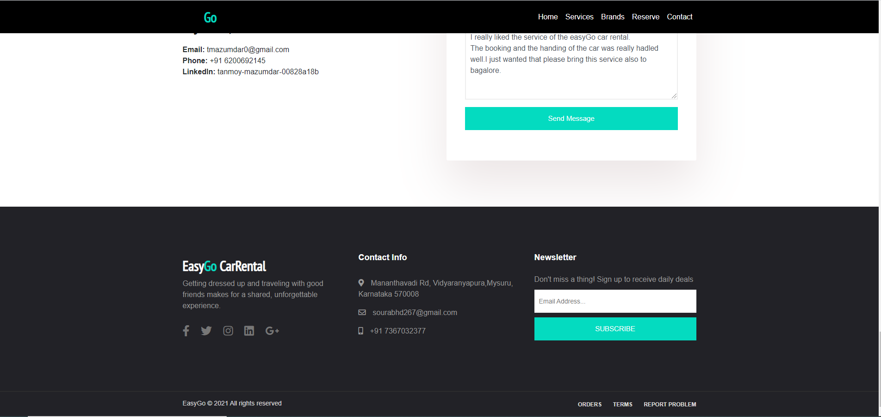
User can subscribe to the News Letter by Easy Go car rental for exciting Deals

Slide 18
THE FOLLOW UP SLIDES ARE FOR THE ADMIN OF THE SERVICE

Slide 19
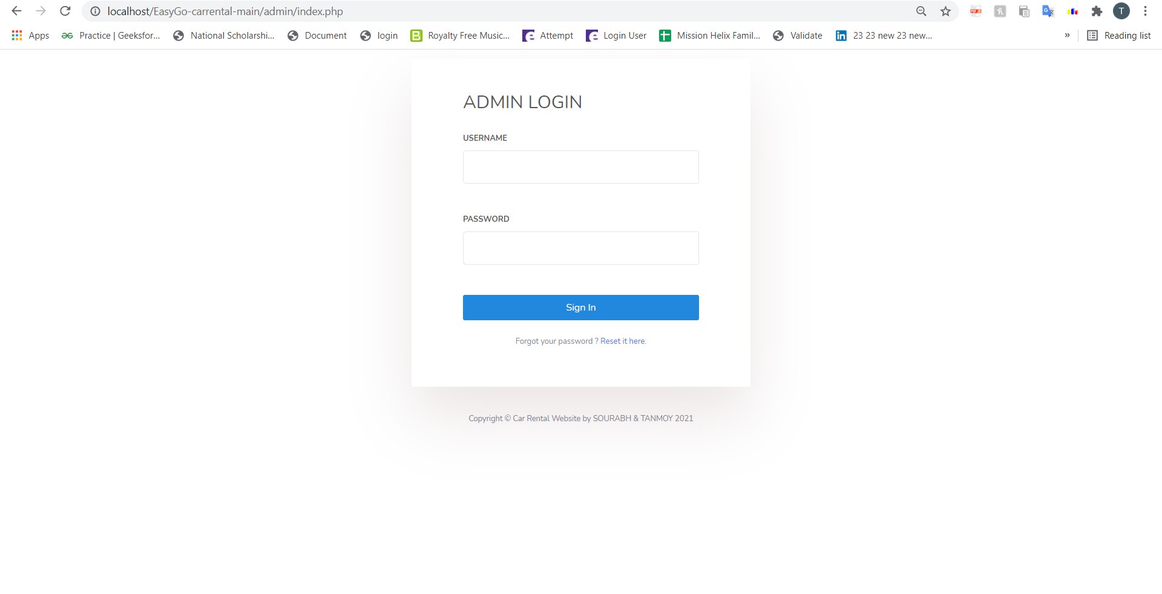
Admin Login Page

Slide 20
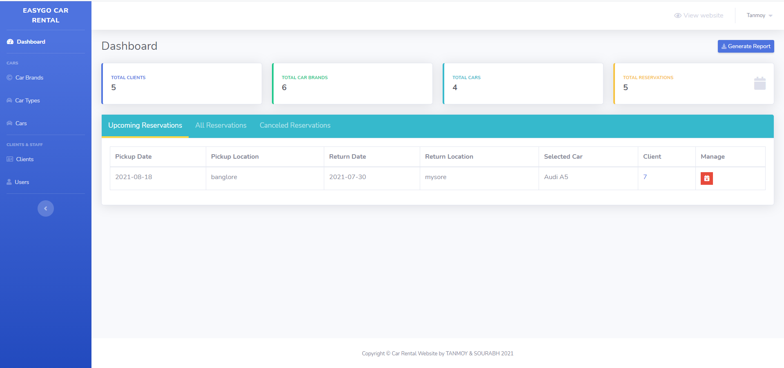
Admin Dashboard showing the total clients, total cars, car brands and total Reservation and Upcoming Reservation

Slide 21
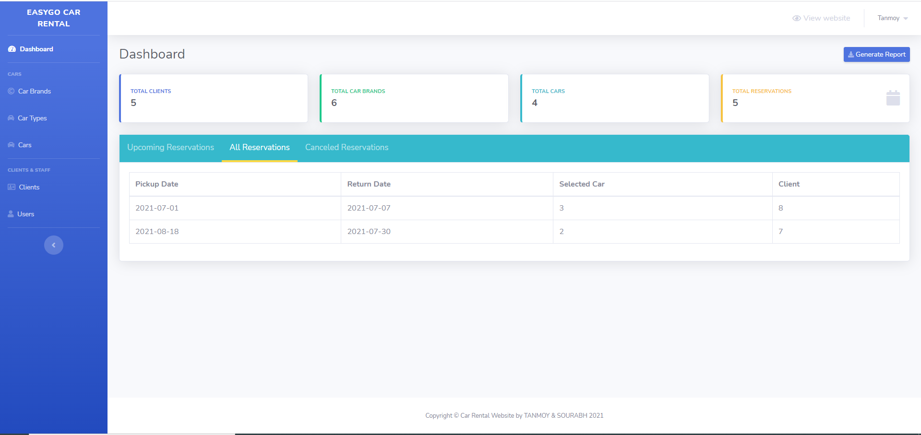
Displaying the details of all reservations in the system

Slide 22

Displaying the details of canceled Reservations in the system

Slide 23
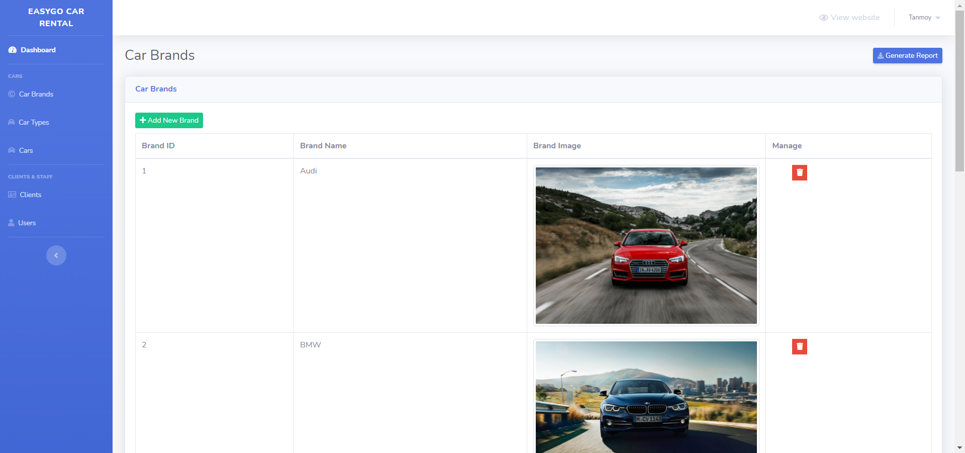
Displaying details of the car brands in the system

Slide 24
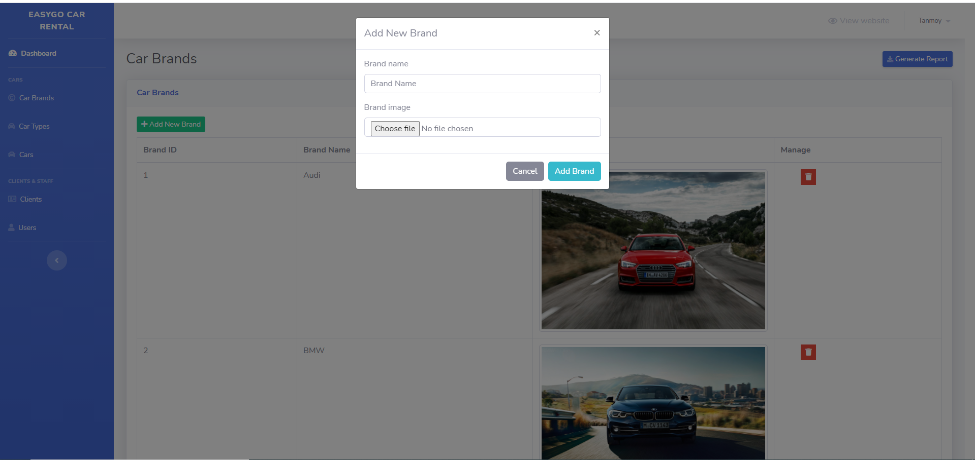
The admin can add new brand of car in the system

Slide 25
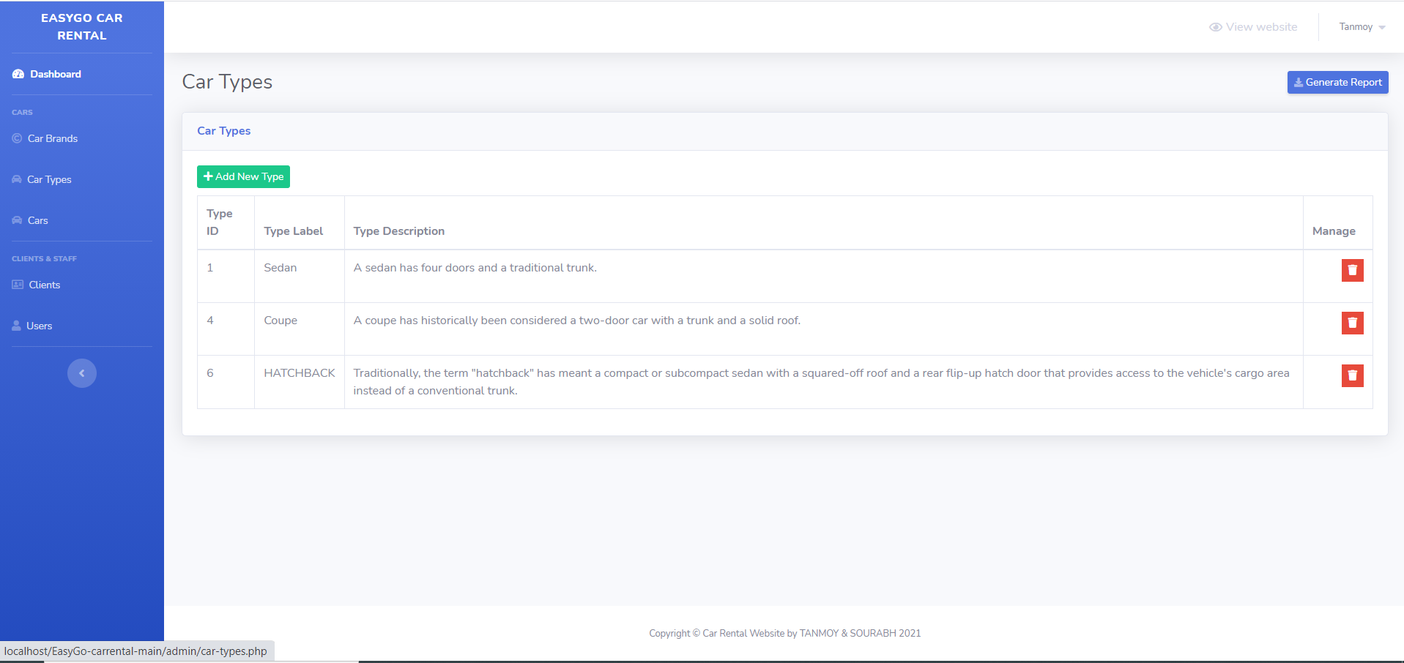
Displaying the details of the Car Types

Slide 26
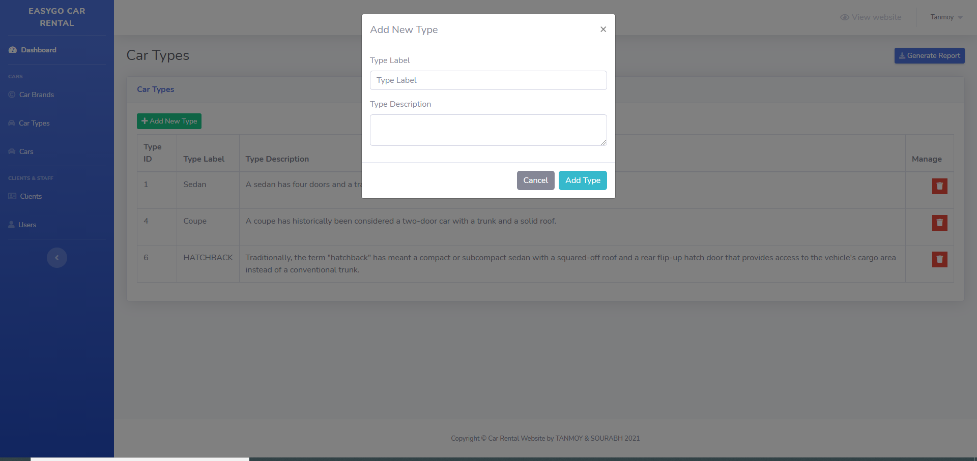
Admin can add new car type

Slide 27
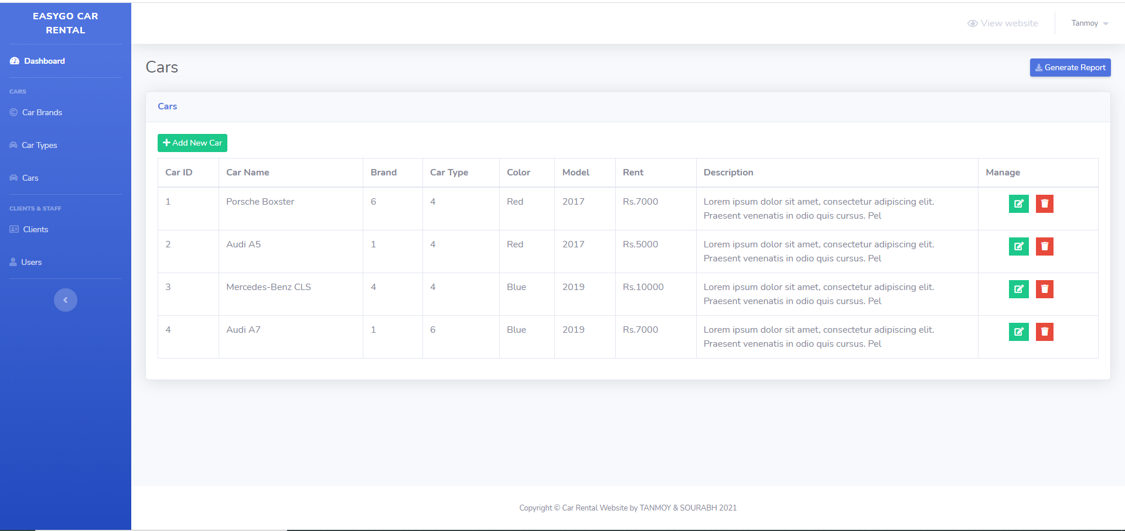
Displaying the details of the Cars in the System

Slide 28
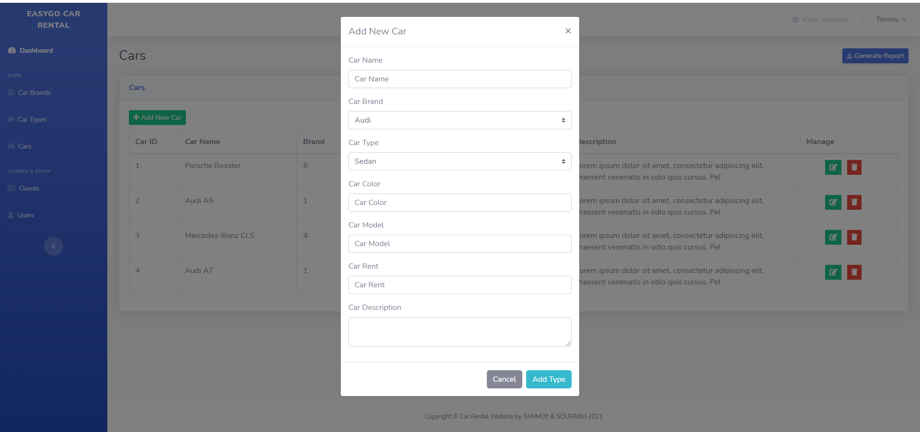
Admin could add new Car in the system

Slide 29
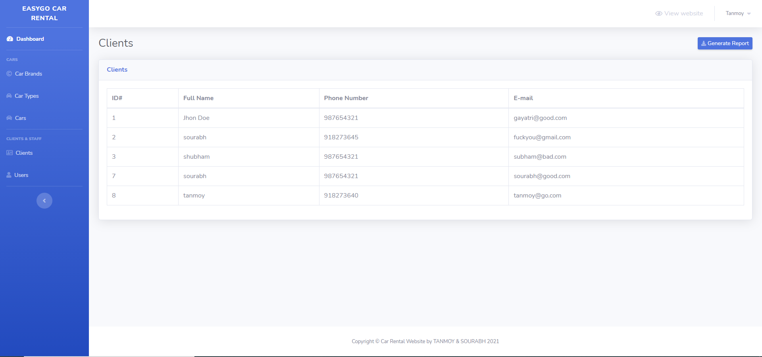
Displaying the details of the Clients in the system

Slide 30
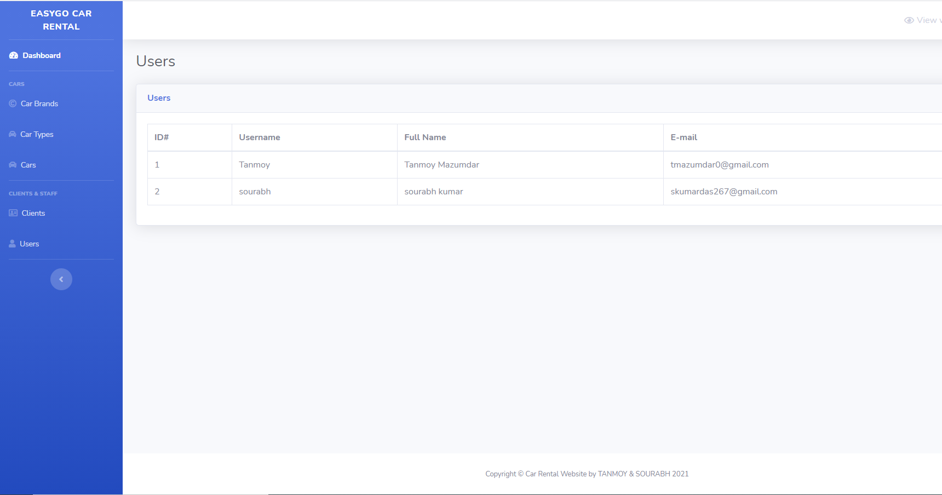
Displaying the Details of the no of admins in the system

Slide 31
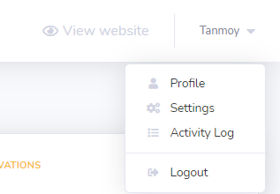
Admin can log out from the System

Slide 32
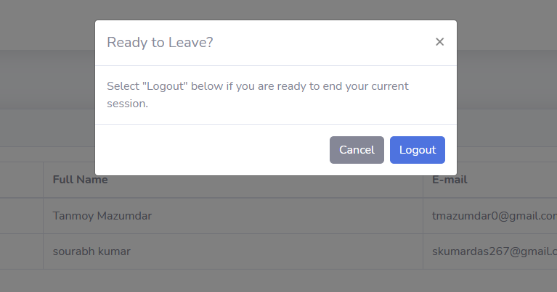
Dialog box confirming if the user would like to log out of the system or not

Slide 33
Admin can log out of the system

Slide 34
THE FLOLLOW UP SLIDES ARE THE DATABSES ENTITIES IN THE XAMPP SERVER

Slide 35
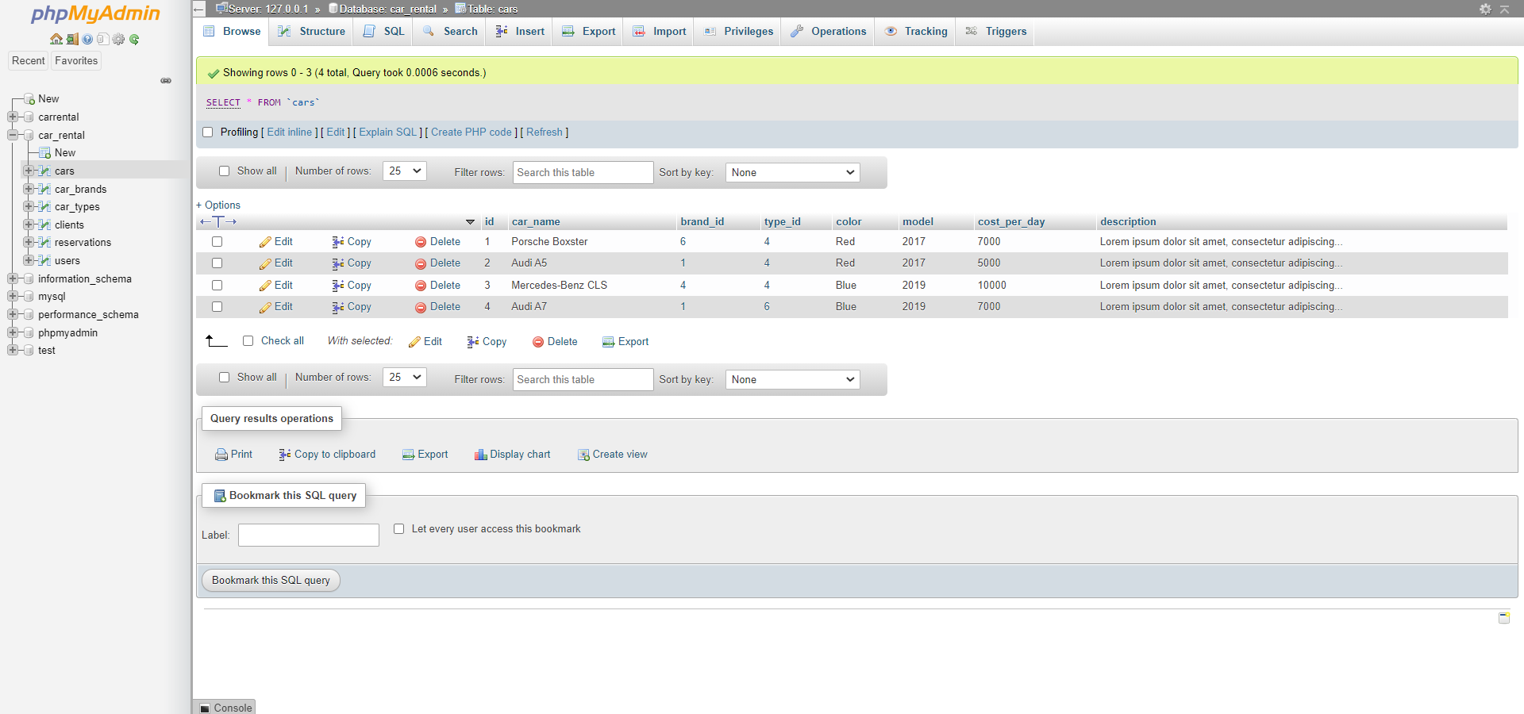
Cars Entities table with its attributes(columns) in detail in the XAMPP Server

Slide 36
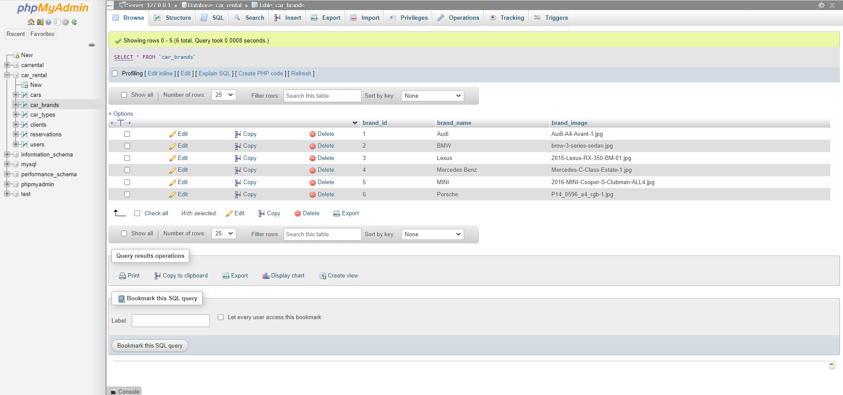
Cars_brand Entity table with its attributes(columns) in detail in the XAMPP Server

Slide 37
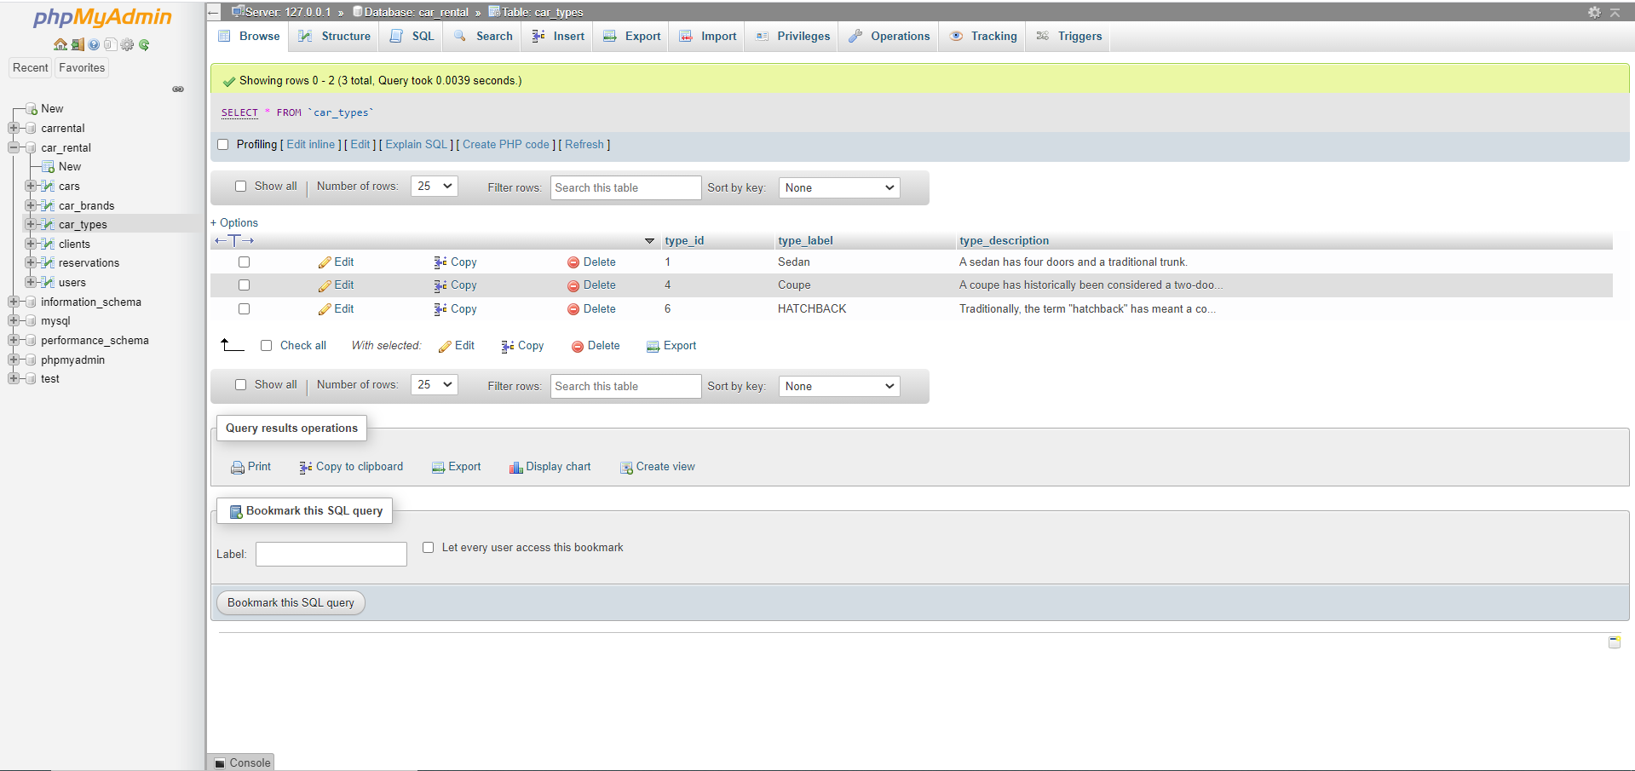
Cars_type Entity table with its attributes(columns) in detail in the XAMPP Server

Slide 38
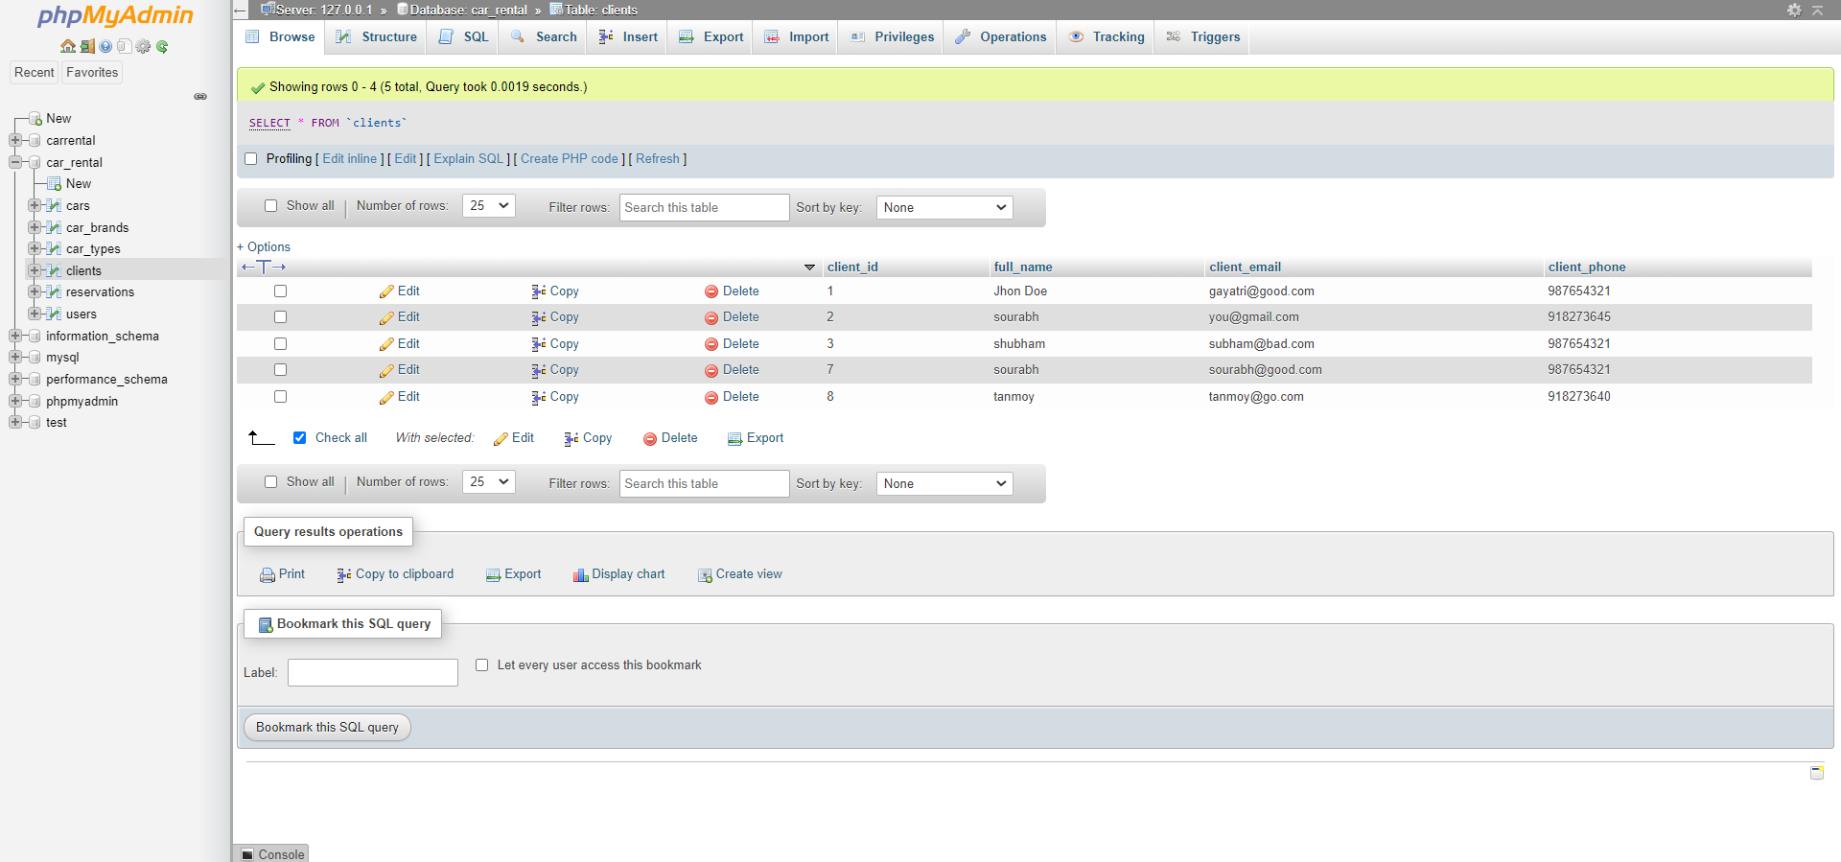
Clients Entity table with its attributes(columns) in detail in the XAMPP Server

Slide 39
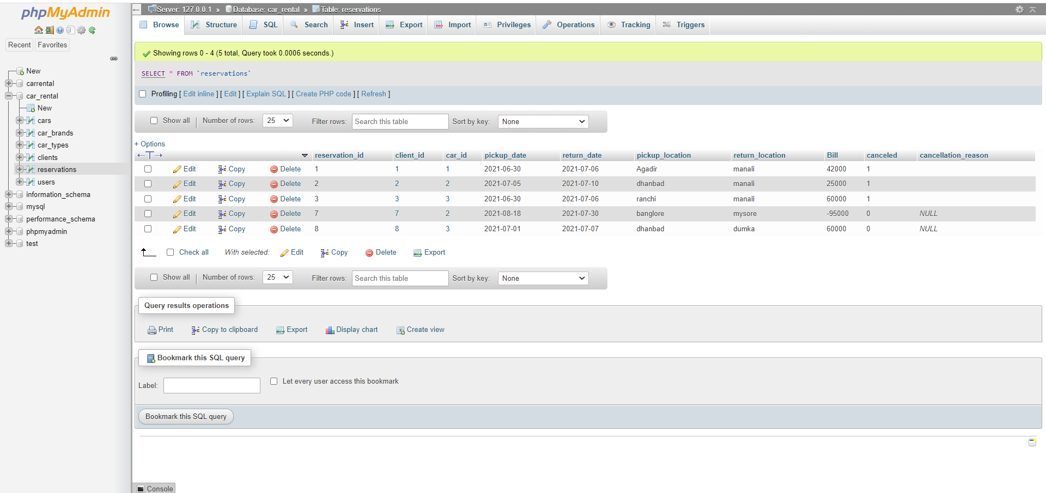
Reservations Entity table with its attributes(columns) in detail in the XAMPP Server

Slide 40
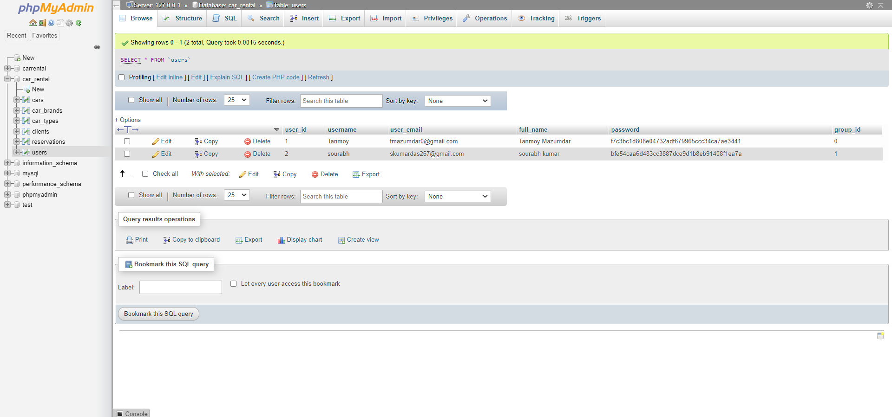
Users Entity table with its attributes(columns) in detail in the XAMPP Server

Slide 41
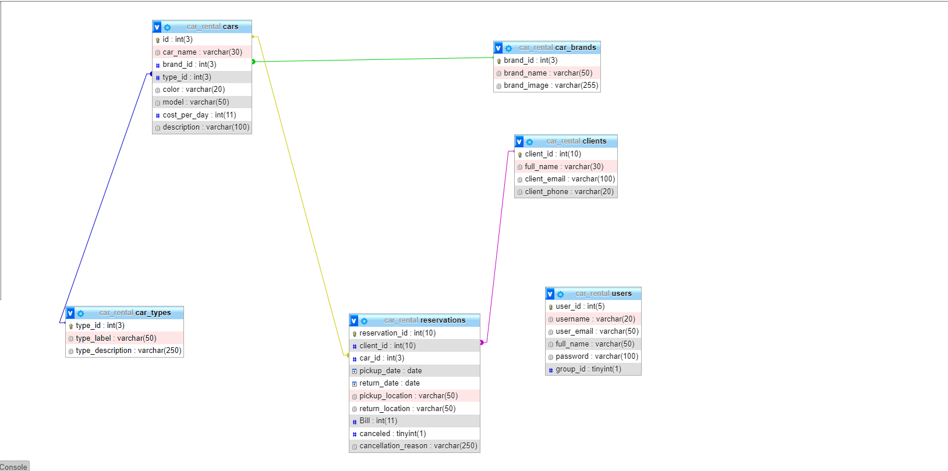
Class Diagram of the database

Slide 42
THANK YOU
PRESENTATION BY- TANMOY MAZUMDAR & SOURABH KUMAR

